Slide 1
How to Evaluate Direct Support Professionals
Using the OPWDD DSP Core Competencies and NADSP Code of Ethics
Presented by:
Perry Samowitz Lead for Region 3 Regional Centers for Workforce Transformation
John Raffaele NADSP Training Consultant

Slide 2
Training Objectives
How to provide an evaluation that supports the morale of
the good to excellent DSPs
How to provide an evaluation for underperforming staff
that gives a clear objective message and possibly goals
to work towards.
How to fill out the 3 Core Competencies evaluation tools

Slide 3
Training Objectives Continued
How to provide on-going supervision and feedback so there are no surprises in the evaluation.
How to ensure that the evaluation is filled out legally and that the facts are presented accurately in behaviorally objective terms.
Demystify and utilize the OPWDD DSP Core Comps and Ethics in the Evaluation process

Slide 4
Demystifying The Core Competencies
23 Competencies used daily by DSPs
Start using the language of the competencies

Slide 5
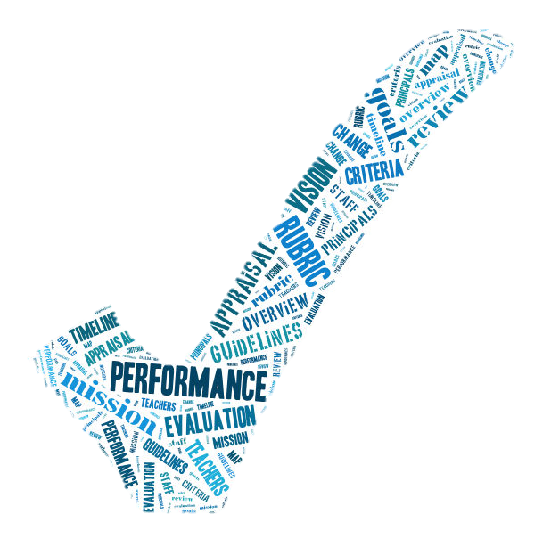
“In sophisticated, well-managed organizations, performance appraisal is the single most important management tool.”
The Performance Appraisal Question and Answer Book by Dick Grote

Slide 6
What is a Performance Appraisal?
It is a formal system to assess how an individual is performing within an organization.
It includes the completion of a standardized evaluation tool which summarizes a year’s worth of work, feedback and supervision meetings.

Slide 7
What is a Performance Appraisal? Continued
It is an opportunity for a supervisor to review with the DSP in a face to face meeting his/her progress.
This progress is based upon an agreed set of standards and a formalized goal planning process.

Slide 8
Why Evaluate Performance?
Provide accurate feedback to reinforce accountability of performance based upon the
Core Competencies and the Code of Ethics.
Coach and Mentor to encourage improvement and motivate towards innovation and creativity.
Determine training/development.

Slide 9
Why Evaluate Performance? Continued
Determine and discuss higher-level opportunities and possible promotions
Notifying underperforming staff that their work is substandard and needs to improve immediately.

Slide 10
GE Conducts Scientific Study (1960)
Results are still valid today:
Criticism negatively effects achievement of goals.
Unspecified praise has little effect, one way or the other, on performance.
Performance improves when specific goals are established.
Coaching should be frequent, not one time per year.
Participation by the employee in the goal-setting procedure help produce favorable results.

Slide 11
Provide Feedback in a Fair and Timely Manner
The purpose of feedback is to reinforce or change behavior
Areas to give feedback include staff’s ability to:
Support people as written in the Core Competencies
Adhere to the Code of Ethics
Demonstrate professional behavior in the work place based on the competency #3

Slide 12
Discuss expectations
Review NY State DSP Initial Evaluation Tool at the beginning of employment

Slide 13
Set initial goals
based upon the competencies:
Treat individuals with respect, putting them first, and building positive relationships (1&2)
Learn health and safety policies and procedures (4&5)
Develop professional skills (3)
Emphasize how to use the NADSP Code of Ethics in daily practice (3)
Assist in using the community (7)

Slide 14
Assess Performance All Year Long
This is the NUMBER ONE Responsibility of any supervisor
Regularly assess staff’s ability to manage responsibilities:
Have Coach and Mentoring meetings
Touch base often
Implement regularly planned and unplanned observations
Provide on-going feedback to both praise and improve performance
Best Practice is to meet for supervision at least once a
month (more if needed)

Slide 15
Giving Feedback
Be tactfully honest and supportive
Discuss the behavior not the person
Do not sandwich developmental feedback in the middle of praise
Confront and correct serious performance problems immediately:
Address
Document
Follow-up

Slide 16
STAR WAR Feedback System
Situation or Task
Action by staff
Result on others
What alternative action
Alternative Result

Slide 17
The Good Staff (don’t have to use the number ratings)

Slide 18
Key Principles in Giving Evaluations
Maintain and enhance self-esteem
Listen and respond with empathy
Encourage involvement
Share thoughts and rationale, not feelings
Provide support without removing responsibility
Utilize Competencies and the Code of Ethics ongoing

Slide 19
Opening Statement of Evaluation for Good to Excellent Workers
Start the meeting by making an introductory statement consistent with his/her overall rating.

Slide 20
Opening Statement of Evaluation for Good to Excellent Workers Continued
“You are an exceptionally talented staff and are
ready for more responsibilities or promotion.”
“You are a very good worker who overall
consistently meets most of the standards of the
Core Competencies and the Code of Ethics.”

Slide 21
Thank Them
For good to excellent staff, one of the main purposes of the evaluation is to let them know that they are appreciated and to be thanked for their hard work.
Your opening statement should start with a thank you.

Slide 22
Review Instructions on Core Competencies Evaluation Tool

Slide 23
Review the Family/Individual Evaluation Tool
When to use:
Augment the Initial or Annual Evaluation Tools
To evaluate staff who are rarely seen by supervisor such as in Community Hab. and Self Directed Services.
Use of Suggested Questions by supervisor with family/individual

Slide 24
Best Practice System For the Annual Evaluation
Preparation
Pre-meeting
Schedule face to face meeting

Slide 25
Preparation
Review year’s worth of documentation including “Feedback Forms”
Quickly check all skills without stopping to think
(Speed …filling out.. Evaluation…explain..)
Review for accuracy

Slide 26
Preparation Continued
Determine overall score
Complete the tool with limited writing. Don’t rewrite what is written, only fill in the comments box to highlight outstanding work or areas to grow.
Review with your supervisor
This a legal binding document

Slide 27
Best Practice Pre-Meeting
Occurs approximately a week or two before the evaluation meeting
Discuss the purpose of an evaluation
Provide overall rating to decrease anxiety
Review the tools and the evaluation system
Meeting standards (1)
Exceeding standards (2)
DOES not meet standards (0)
Be economical with exceeding standards

Slide 28
The Underperformer (Approval needed according to agency policy)

Slide 29
Opening Statement of Evaluation for Underperforming Staff
“You have been struggling all year to meet the standards of the Core Competencies and the Code of Ethics and overall
you have been underperforming.”
"I believe you have the ability to meet the standards and we will create a short term plan to do so.” OR
"I believe it is time to either look for a better job match or to place you on disciplinary action based upon our agency’s policy."

Slide 30
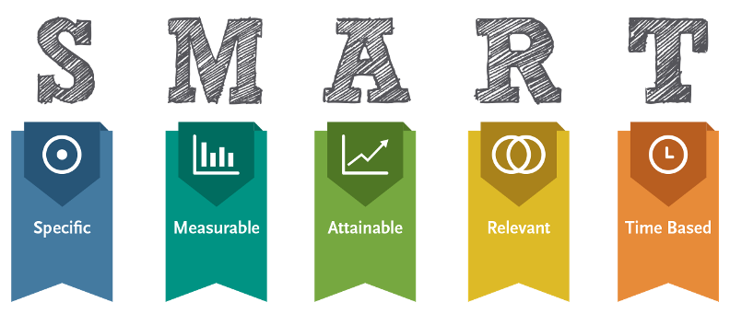
Goal Setting

Slide 31
Exercise in Writing S.M.A.R.T. Goals
Select one of your current staff (don’t use real name)
Look at the Core Competencies Goal 1 : Putting People First
Choose one goal that you would like to have the staff attain
Write the SMART goal
Specific
Measurable
Attainable
Relevant
Time Based

Slide 32
The Perfectionist (Promotions are based upon agency policies)

Slide 33
Opening Statement of Evaluation for Underperforming Staff Continued
Document meeting,
clearly review expectations,
notify your supervisor and HR, and
follow-up in a timely manner.

Slide 34
Tips While Evaluating
Give the overall score first
You can negotiate a score with a good to excellent staff person if it does not greatly change the overall.
Remember, morale is essential.
Assess emotional thermometer. If necessary stop the process and remind staff of overall rating. Do not get into a power struggle. There should be nothing new in the evaluation that the staff has not already heard.

Slide 35
Tips While Evaluating Continued
Develop a plan to support staff in improving performance including time frames.
For good to excellent staff, end the evaluation with a thank you.

Slide 36
Major Sins of Performance Evaluation
The sin of inflation – avoid addressing underperforming issues leading staff to believe they are performing at a higher level than they really are.
The sin of surprise – saving “bad” news for the evaluation.
The sin of vagueness – “keep up the good work”.
The sin of brevity – not leaving enough time for the evaluation.

Slide 37
Don’t
Don’t allow the halo/horns effect – one aspect of the
staff’s performance –good or bad- to influence the entire
evaluation.
Don’t give a partial rating – based only on the last few
months.
Don’t show favoritism - this will discredit you as a
supervisor in the eyes of others.

